Slide 1
A fully Bayesian inference for Contaminant source identification
Inverse Problem with Convolutional Neural networks
Zitong Zhou
04/05/2021

Slide 2
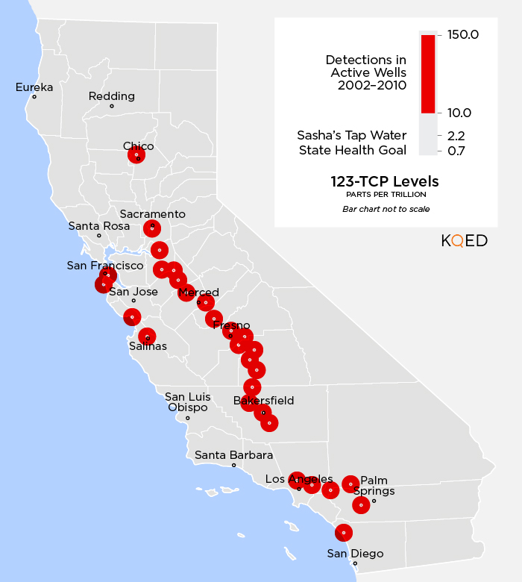
Problem Background
An example of organic contaminant:
Trichloropropane (TCP, used in industrial solvent production) enters drinking water[1]. TCP is on the list of cancer causes[2].
TCP is banned from use in soil fumigants now, but breakdown of it in the soil is slow.
Source identification is needed for further removal of TCP!
1: https://www.cleanwateraction.org/features/tcp-californias-drinking-water
2: https://oehha.ca.gov/proposition-65/crnr/chemical-listed-effective-december-4-2015-known-state-california-cause
3: SOURCE: CALIFORNIA STATE WATER RESOURCES CONTROL BOARD, MAP: Teodros Hailye, KQED Science

Slide 3
Contents
Problem Definition
Forward simulation
Quantity of interests
Design Elements
Conductivity field reparameterization
Forward model neural network surrogate
Inverse process
Numerical Experiments

Slide 4
Problem Definition: transport of the contaminant
1. In general:
Darcy flow:
Advection-diffusion-reaction transport equation:
The reaction terms represent sorption and first-order rate reaction:
2. In our study:
single specie, Freundlich sorption, no degradation:

Slide 5
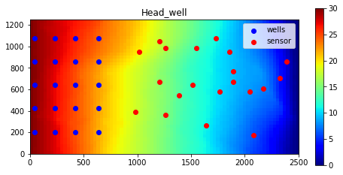
Problem Definition: a forward transport example

Slide 6
Problem Definition: measurements and unknowns
Measurements: on locations: concentration and hydraulic head:
Unknowns: injecting concentration and hydraulic conductivity field
1 location && 5 release concentration && hk ~ 19932 parameters
Objective: distributions of the unknown parameters
Challenge: parameterization of the 3D conductivity field

Slide 7
Parameterization of the conductivity field Convolutional adversarial autoencoder(CAAE)
x: the conductivity field. :the data distribution, with complicated spatial correlation
D: discriminator, computes if the sample x is from ;
G: generator, the decoder in the above image.

Slide 8
Forward Model Surrogate Bayesian Convolutional Encoder-Decoder networks
Each forward simulation takes ~30 seconds!
Previously: use a convolutional Dense Encoder-Decoder NN(DEDNN)
In this work: use a Bayesian DEDNN
Dataset:
A deterministic neural network:
Obtain of the parameters:
Bayesian neural network:
Obtain of the distribution of parameters:
🤔🤔🤔🤔🤔🤔

Slide 9
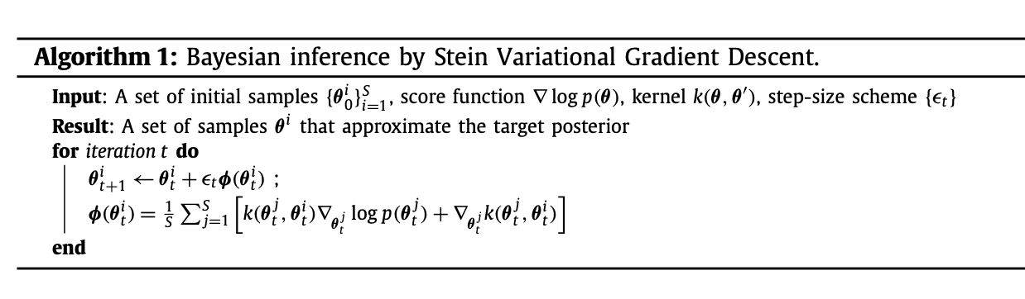
Bayesian Neural Network surrogates SVGD
Only if an ensemble of samples could be obtained.
Bayesian Inference:
Unnormalized posterior of w
With ~20 samples obtained for the parameters:

Slide 10
The Inverse Process
Represent hydraulic conductivity field with low dimensional latent variable z, from standard normal distribution.
Build Bayesian forward surrogate model, ~20 neural networks as an ensemble.
Inverse process: sample from the posterior distribution:

Slide 11
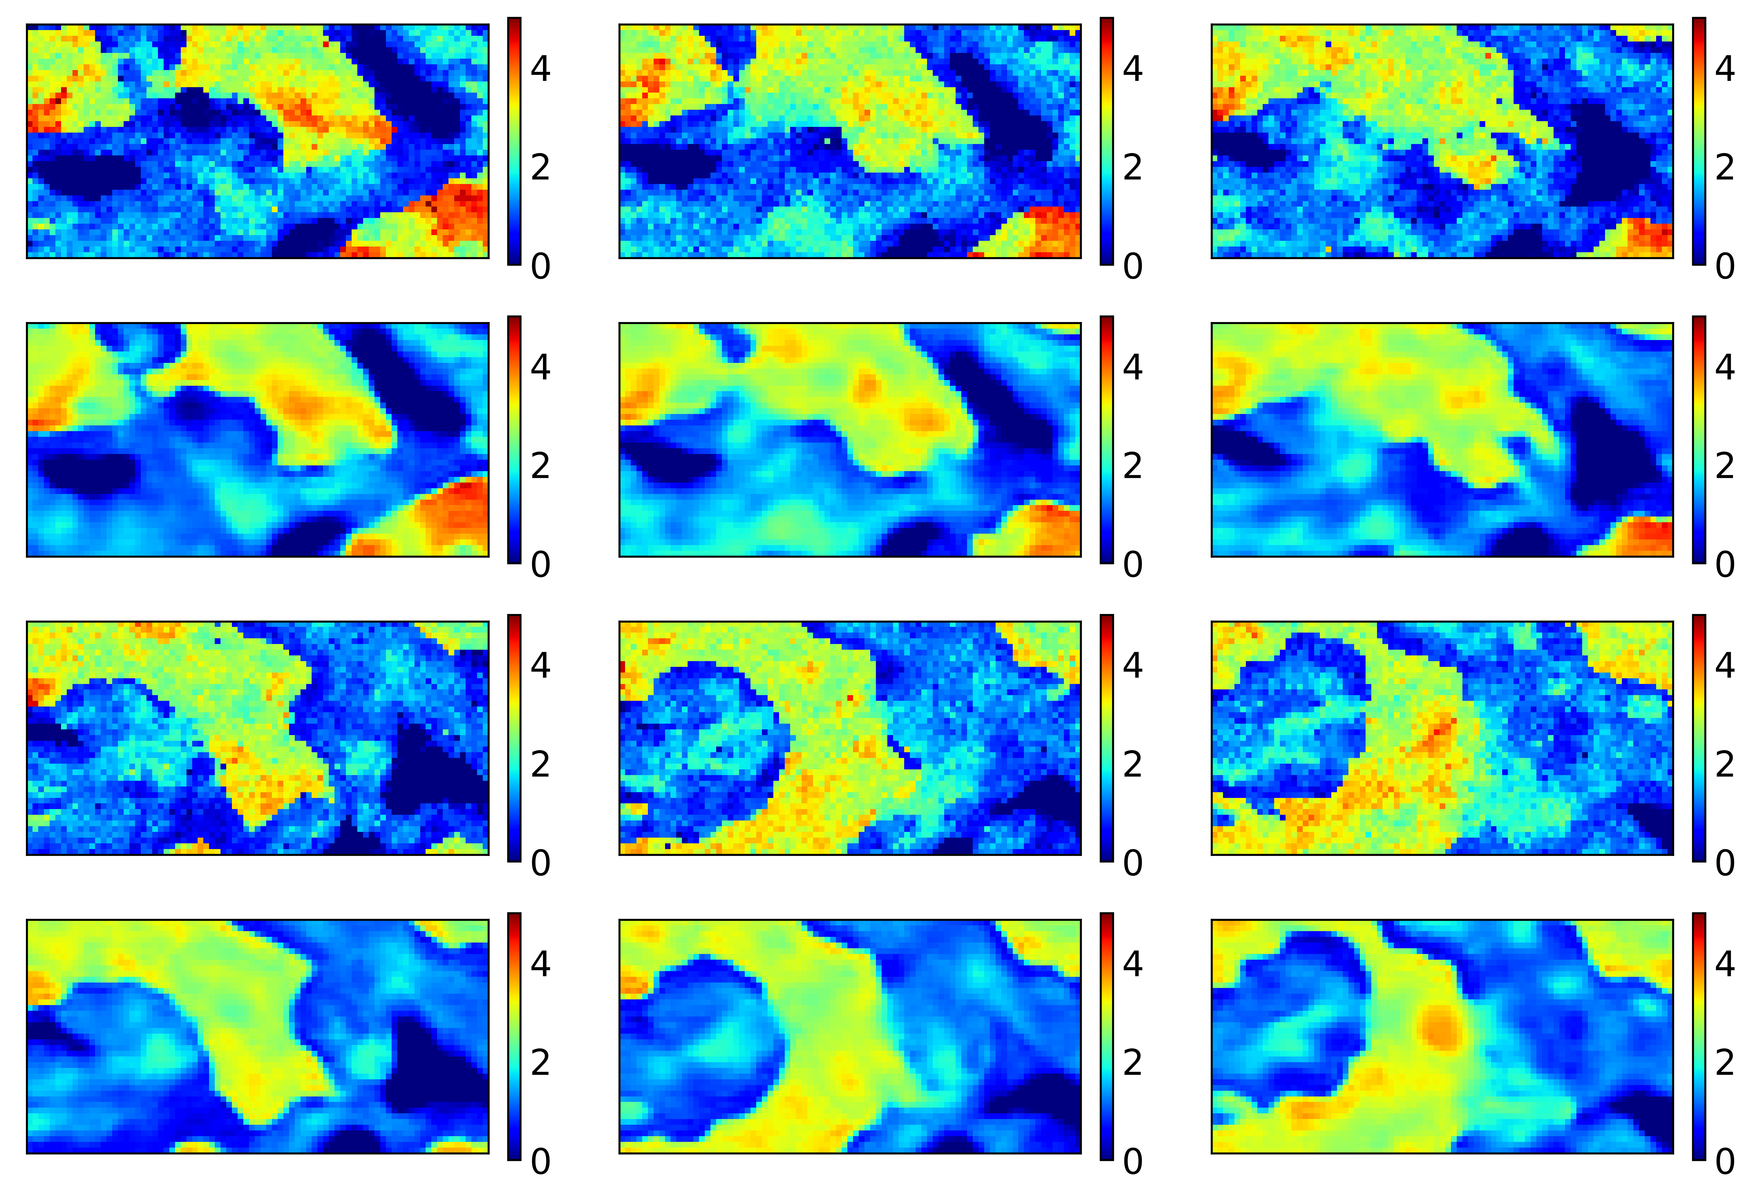
Numerical Experiments
CAAE for the hydraulic conductivity field, 924 latent variable:

Slide 12
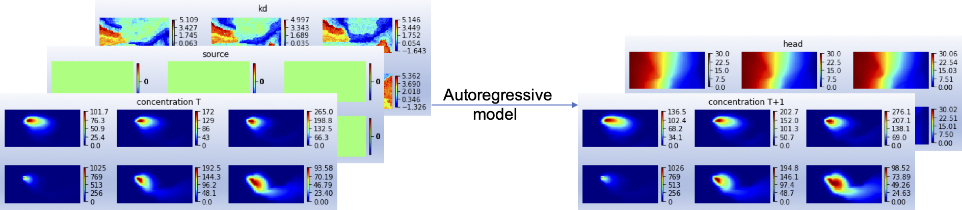
Numerical Experiments
Auto-regressive model, only predicts 1 timestep

Slide 13
Numerical Experiments
Bayesian DEDNN with 20 particles:

Slide 14
Inversion
Ensemble smoother:
To be done soon

Slide 15
Thanks!
Questions?

